Slide 1
Unit 10 Probability
Algebra 1

Slide 2
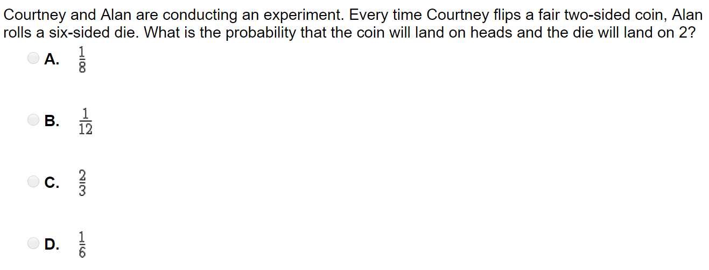

Slide 3
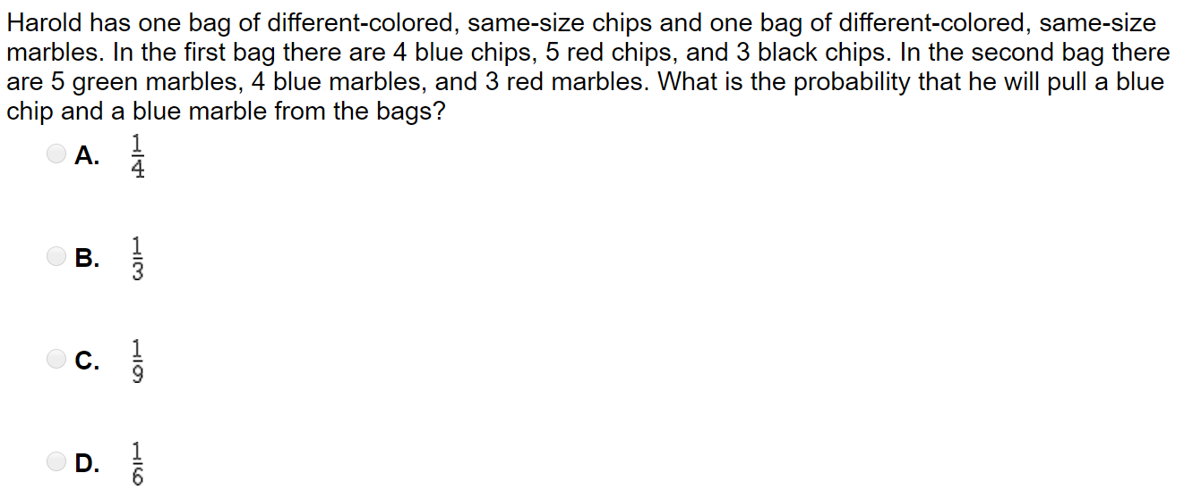

Slide 4
